Slide 1

Department of computer Application University Institute of Technology Rajiv Gandhi Proudyogiki VishwaVidyalaya
A MINOR PROJECT PRESENTATION ON
HR REPORT
SUBMITTED TO : SUBMITTED BY:
DEPARTMENT OF COMPUTER APPLICATION SHRAY CHATURVEDI PROJECT GUIDED BY HARSHAD BANSOD
MS, ANJANA PATNEY
RESEARCH SCHOLAR CLASS :- MCA 3rd SEM

Slide 2
Introduction
HR REPORT is a Java based web server on which Hr can manager the details of there employees. In this full-stack project, we will learn how to develop a simple end-to-end full-stack web application that is basic Employees data Managing Application using React, Spring Boot.

Slide 3
What is java web server?
A Web server from Sun that ran under Solaris and NT. It supported Java servlets and Java Server Pages (JSP) technology. Version 2.0 was the final release of the product, which was created to provide an upgrade path to servlet processing (Servlet API 2.1) for prior Java Web Server customers.

Slide 4
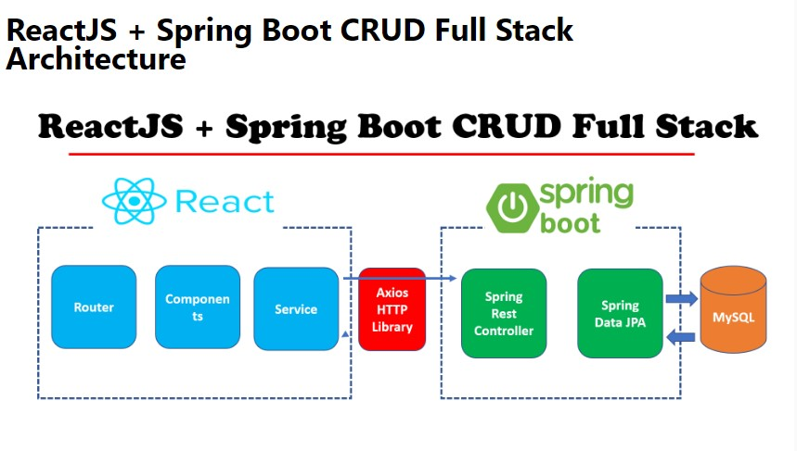

Slide 5
Tools and technologies
Server-side tools and technologies used :-
• Spring Boot
• Spring Data JPA ( Hibernate)
• Maven
• JDK 1.8 or later
• Embedded Tomcat
• MySQL Database

Slide 6
Client-side tools and technologies used :-
•React
•Modern JavaScript (ES6)
•Node JS and NPM
•VS Code IDE
•Create React App CLI
•Bootstrap and HTTP Library

Slide 7
Features
Easy Accessibility:
Records can be easily accessed and store and other information respectively.
CURD:
The data can easily create, update, delete and view by Admin.

Slide 8
Ready to Deploy:
To deploy your Java Web Start application, first compile the source code, package it as a JAR file, and sign the JAR file.
Java Web Start applications are launched by using the Java Network Launch Protocol (JNLP). Hence, you must create a JNLP file to deploy your application.
The Deployment Toolkit script contains useful JavaScript functions that can be used to deploy Java Web Start applications on a web page.
Easy maintenance:
Hr Report design as easy way. So maintenance is also easy.

Slide 9
Modules used in app
Create a Servlet – BackendAppication.java
View in JSP – FrontendApplication.jsp
Add Data in backend – Add.java
Add Data in Frontend – Add.jsp
Manage Data in Backend – Employee.java
Manage Data in Frontend – Employee.jsp

Slide 10
Hardware Requirements
i3 Processor Above
4-GB RAM or Above
200 GB Hard-disk or Above

Slide 11
software Requirements
Window 7 or higher
Java EE
SpringTool Framework
MySQL Database
VS Code

Slide 12
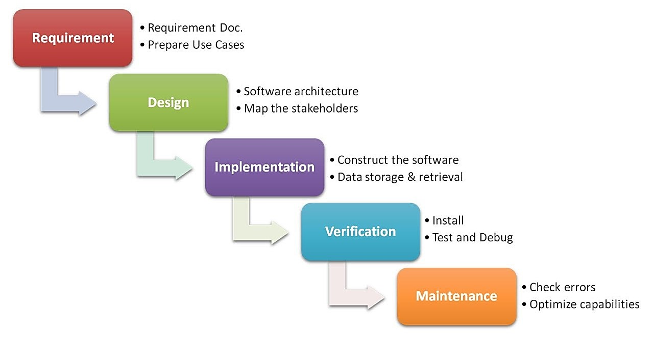
Waterfall model

Slide 13
Use case diagram
Admin Login
to dor list
et View Details do list
Admin
Add/Delete Details
Update Details
RLog Out

Slide 14
Output screens

Slide 15
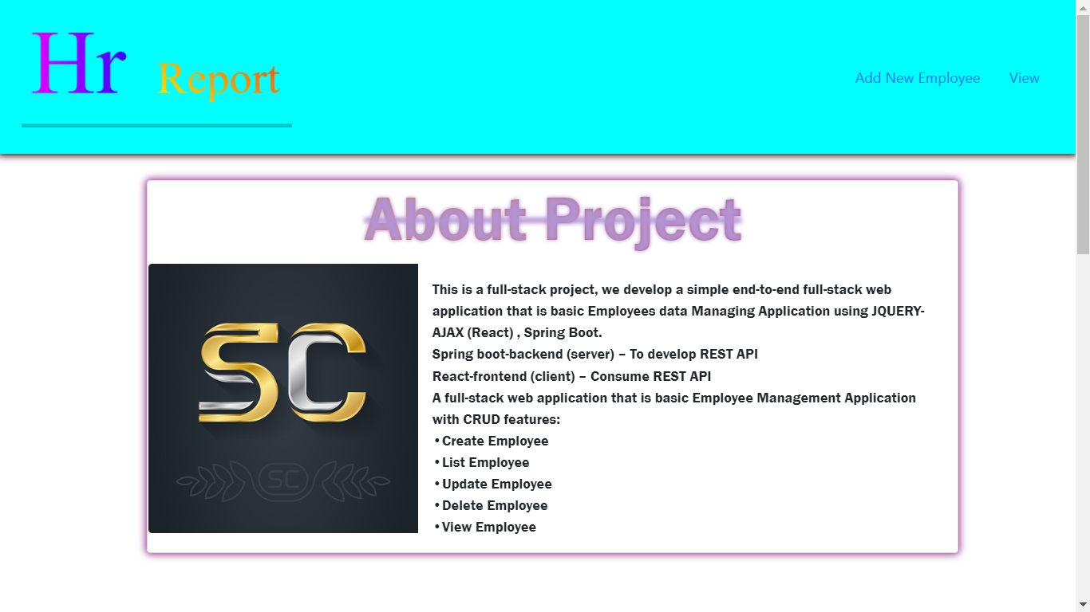
HOME PAGE

Slide 16
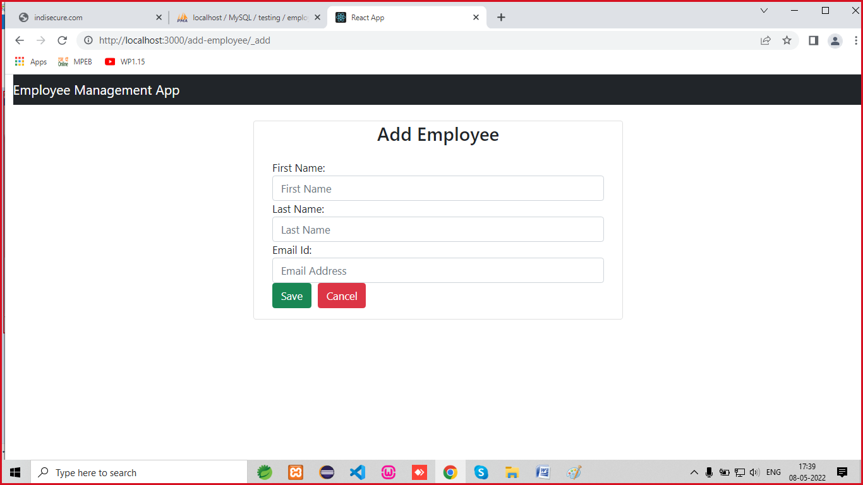
ADD EMPLOYEE page

Slide 17
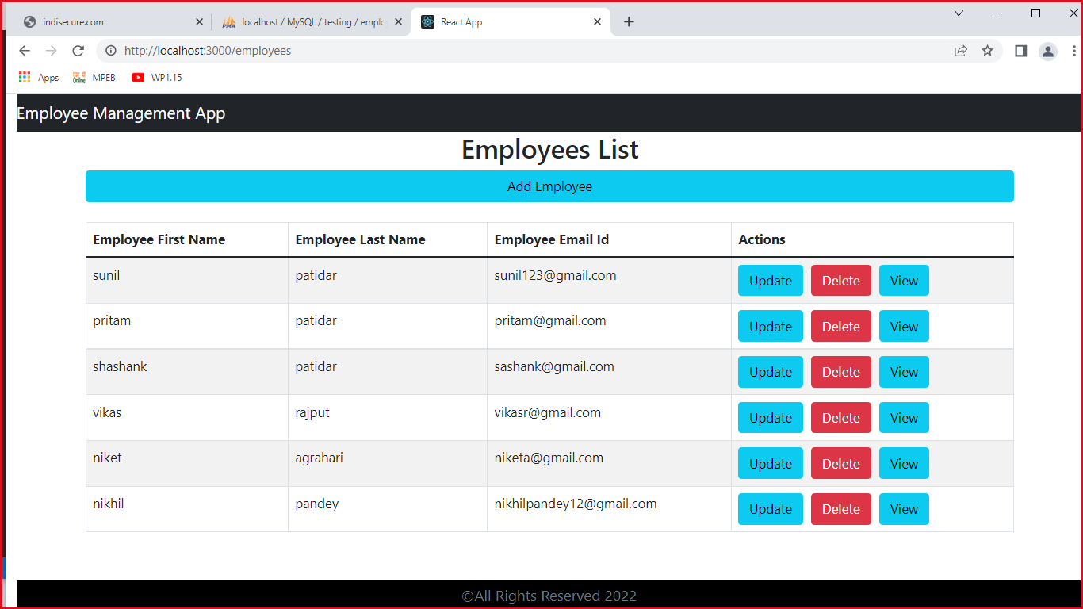
MULTIPLE OPTION page

Slide 18
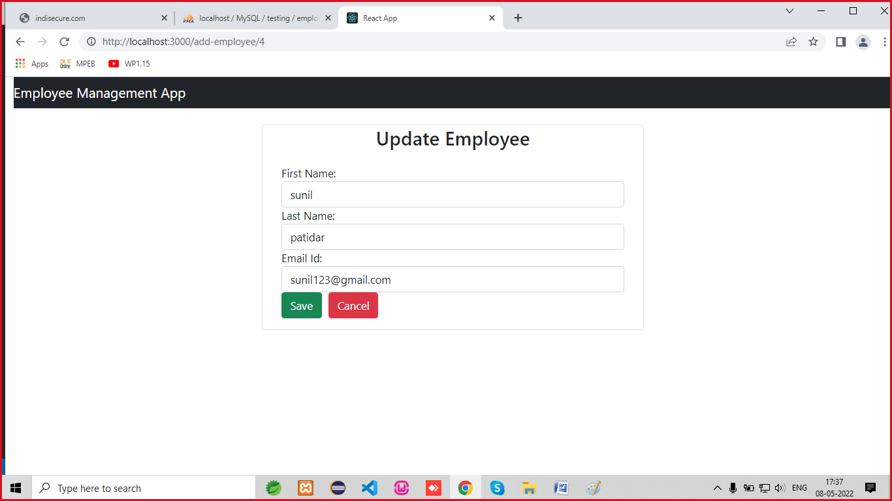
UPDATE DATA PAGE

Slide 19
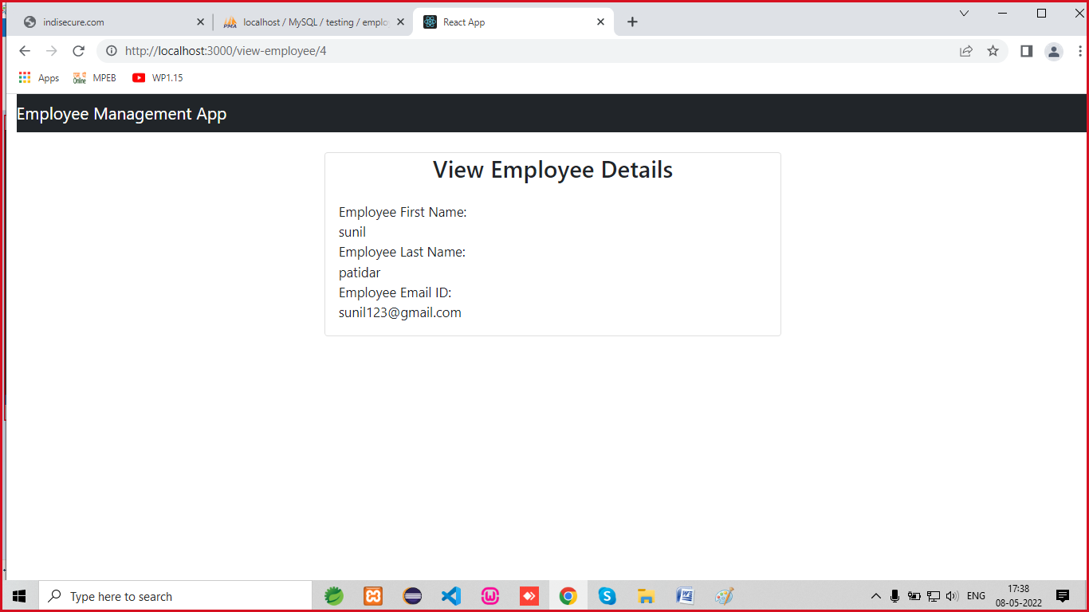
View DATA PAGE

Slide 20
Advantages
Its REST API.
Its MERN Architecture.
Its Web Server features.
Its React Platform Implementation.
Its Spring Tool Setup.
Its CURD operation.

Slide 21
FUTURE ENHANCEMENT
User Section
Security Modules
Separate Section for Everyone
Add Extra Feactures

Slide 22
conclusion
This was our project of System Design about “HR REPORT” developed as a web application developed in Java programming language. The Development of this system takes a lot of efforts from us. We think this system gave a lot of satisfaction to all of us. Though every task is never said to be perfect in this development field even more improvement may be possible in this application. We learned so many things and gained a lot of knowledge about development field. We hope this will prove fruitful to us

Slide 23
Thank you

